Slide 1

CSE 4205 Digital Logic Design
Digital System
Course Teacher: Md. Hamjajul Ashmafee
Lecturer, CSE, IUT
Email: ashmafee@iut-dhaka.edu
Notes:
What is digital computer? Examples where we can use this thing.

Slide 2
Remaining to Add
Review other books and internet resources
Notes:
What is digital computer? Examples where we can use this thing.

Slide 3

Digital System and Digital Computer
The present technological period is highly influenced by digital systems
Also known as digital age
Digital systems are used in, for example:
Communication
Business transections
Traffic controls
Spacecraft guidance
Medical treatment
Weather monitoring
Commercial, Industrial and scientific enterprises
Most of these devices have a specific digital computer embedded within them
A digital computer is ubiquitous because of its generality
Notes:
Digital system and Digital computer are complement to each other.

Slide 4
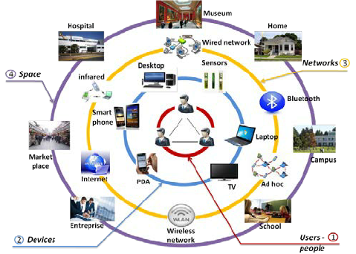
Generality of Digital Computer
Generality of digital computer:
It follows a sequence of instructions (program)
It operates on data (user given data)
Based on that program it generates user specific results
For this reason, computer is now universal to perform a variety of information processing task.
Notes:
Basically we are using GUI based computer or mobile phones which are clickable
GUI has made the life simple to be appeared before user and execute commands but it involves a sequence of a lot of complex internal instructions

Slide 5
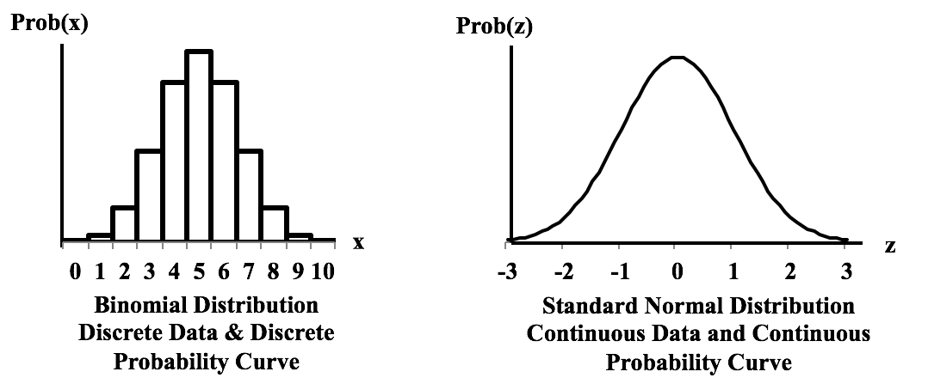
Digital System: Main Feature
:: Process Information
Process and represent discrete elements of information (not continuous)
Number of elements of information is limited to a finite numbered set
These elements are required to represent the information
Example: decimal digits = {0,…,9}
Discrete data
Continuous data

Slide 6
Digital System: and More…
Early computers were used only for numerical computation
Discrete elements were digits at that time
The term - “Digital computer” is emerged from this application
Appropriate name for a digital computer – Discrete Information Processing System

Slide 7
Digital System: Discrete Information
Information basically is represented as signal
Electric signal (continuous) – voltage and current are most common
Generally used by transistors in circuitry of electronic devices
Signals in most electronic digital systems are two discrete values (Binary)
Bit – a binary digit
Two discrete values – 0 and 1
Sometimes discrete information may be represented as group of bits – binary code
To interpret the bit/digit pattern, code system plays a very crucial role
Example: (0111)₂ and (0111)₁₀ are not same in meaning
Binary system is so applicable to represent not only the numbers but also other symbols/characters
Largely used in different electric devices

Slide 8
Digital System: Discrete Information…
Any system uses an alphabet to represent information
English language – an alphabet of 26 letters – e.g. {a, …, z}
Decimal number system – an alphabet of 10 digits – e.g. {0, …, 9}
They could be represented using binary codes as well
Digital system uses an alphabet with two digits(bits) – (0 and 1)
How to represent binary signal:
Example 1– switch (made of transistor) – on and off
Example 2- Voltage values – high (1) and low (0)

Slide 9
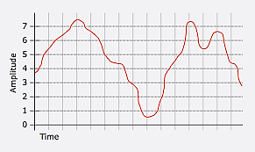
Analog Information
Analog data from any continuous process or nature needs to be converted to digital one
Sometimes an ADC is required to perform quantization on continuous system

Slide 10
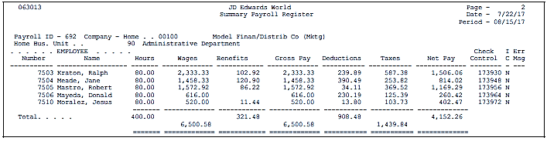
Digital Information
Digital data is the discrete and discontinuous representation of information
Example: payroll schedule of any company having names, ID, salary, income tax, and so on.

Slide 11
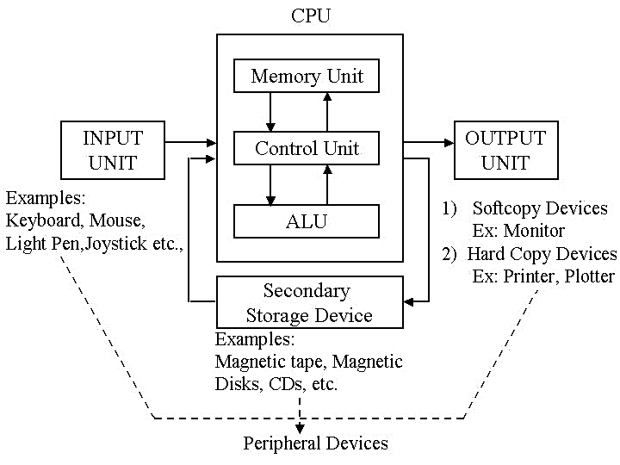
Digital System: An Example
Block diagram of a general-purpose digital computer
Notes:
This computer is used not only to perform arithmetic operations but also to execute logical operations – so this computer can be programmed to make decision based on given conditions

Slide 12
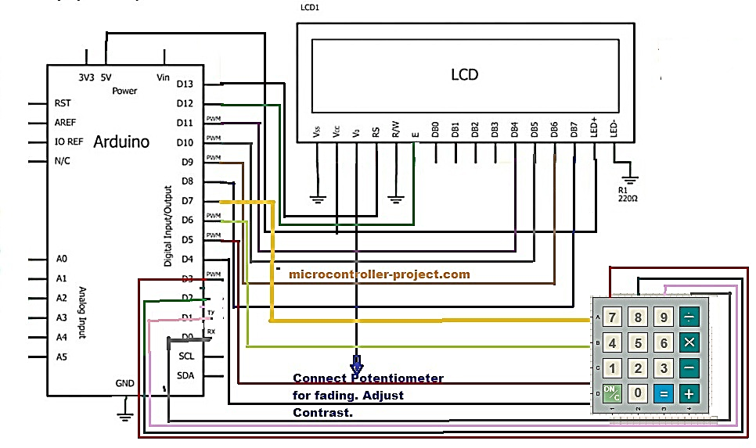
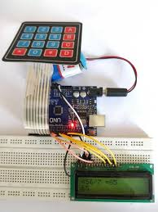
Digital System: An Example
Example: An Electronic Calculator

Slide 13
Digital Systems: Nowadays
Underlying digital computers of most of the commercial digital products are programmable
So that we can change the program keeping the underlying hardware same to perform a variety of applications (generalized and cost effective)
Cost of digital devices’ productions is also reduced
i.e., Number of transistors per unit is increased to produce complex functions whereas the cost per unit is decreased
MIPS rate also does keep increasing (speed of execution)
Increased reliability with error-correction code (better than error detection code)
Notes:
e.g. ECC used in DVD or HDD to store and retrieve back data safely without any loss of any single bit data

Slide 14
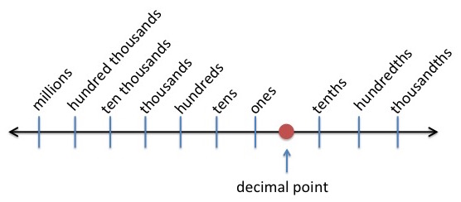
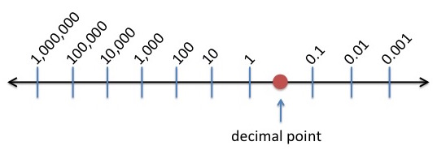
Number system: Decimal Numbers Power of 10
Notes:
Ones also named as units
Give an example how a number is formed from digits.

Slide 15
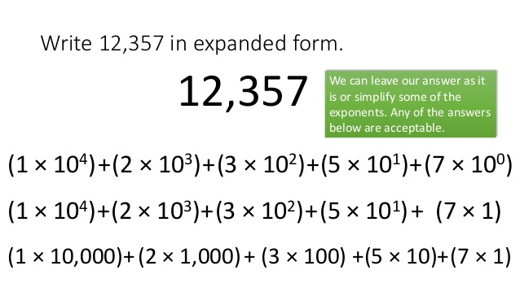
Decimal Numbers: Example
=
=
=
Note: Convention is to write only the digits in any number. From their positions, powers of 10 is deduced increasing from right to left
Notes:
Digits =numerical coefficients

Slide 16


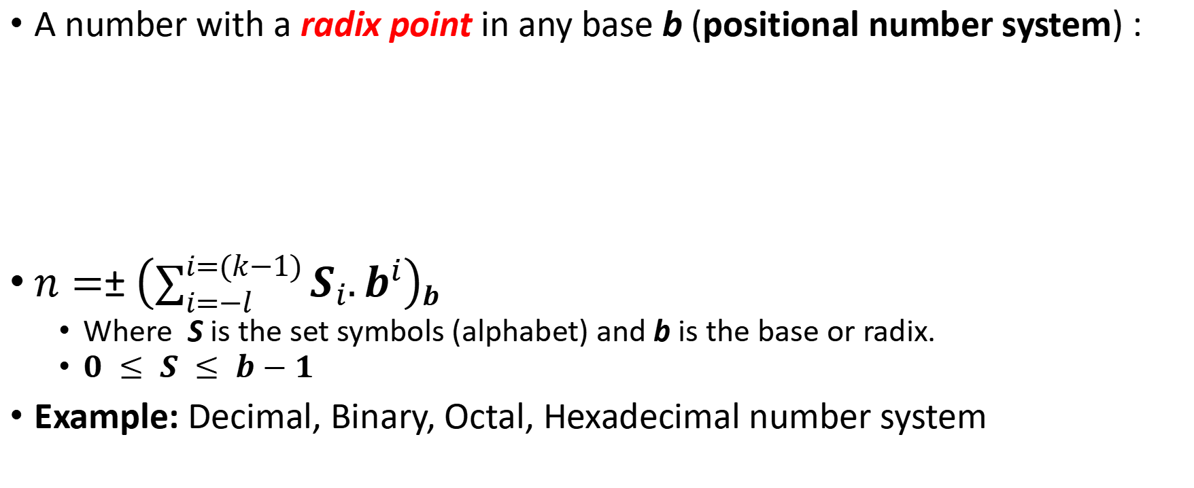
Number system: Formal Explanation
A number with a radix point in any base b (positional number system) :
$n=±\left(\sum_{i=−l}^{i=(k−1)}{S_{i}{.b}^{i}}\right)b$
Where S is the set symbols (alphabet) and b is the base or radix.
$0 ≤ S ≤ b−1$
Example: Decimal, Binary, Octal, Hexadecimal number system
k = # of digits in integers
l = # of digits in fractions
Notes:
The first one is the general format to represent any number with decimal points
Radix point is aliased as decimal point if the base or radix is 10.
It distinguishes the positive powers of radix from the negative powers (Integers and fractions)
Later are the extended format to generate a number
In any number system, there are b number of coefficients or digits.
It is a customary that take b digits from decimal number system. But if b>10, letters from English alphabet are used as a supplement
Each of the coefficients in a number will be multiplied with power of b where power is the position from radix point
We use base b as subscript in the representation by the enclosing parenthesis to denote the base in which a particular number system it is presented except the contents make it obvious

Slide 17
Number system: Its Operations
Arithmetic Operations (Unary and Binary)
Addition (augend, addend, sum)
Subtraction (minuend, subtrahend, difference)
Multiplication (multiplicand, multiplier, product)
Division (dividend, divisor, quotient, reminder)
Negation, Absolute, Increment, Decrement
Carry and borrow is also used in any base b.
How to make the computer understand about decimal point and sign of any number? (mantissa and exponent)
Notes:
Perform a addition (158+249) and subtraction (243-149) to make understand the number system for example

Slide 18
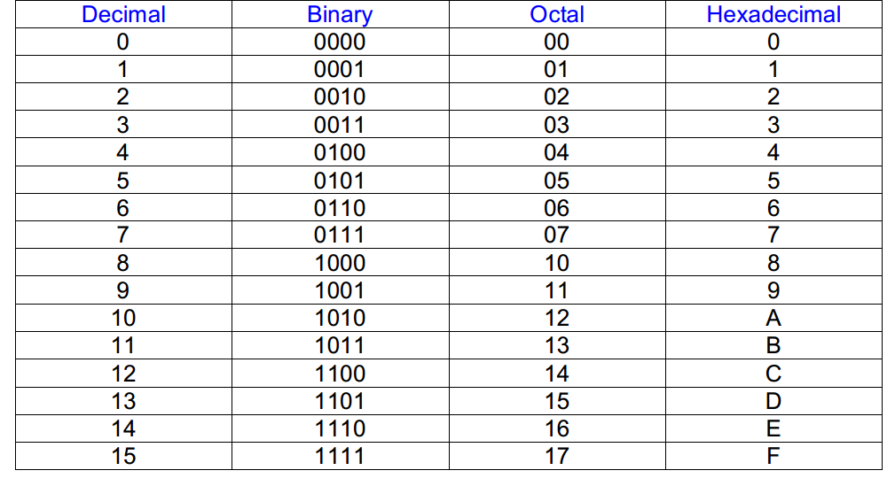
Number System: Different Bases
Notes:
Hexadecimal number system can be used to represent easily long strings of bits in address, instructions and data in computer systems.

Slide 19
Special Powers of 2
2¹⁰ (1024) is Kilo, denoted "K“
2²⁰ (1,048,576) is Mega, denoted "M“
2³⁰ (1,073, 741,824)is Giga, denoted "G“
2⁴⁰ (1.0995116e+12)is Tera, denoted “T"
2⁵⁰ (1.1258999e+15)is Peta, denoted “P“
2⁶⁰ (1.1529215e+18)is Exa, denoted “E“
2⁷⁰ (1.1805916e+21)is Zetta, denoted “Z“
2⁸⁰ (1.2089258e+24)is Yotta, denoted “Y"
Notes:
Usually data stored in bytes (= 8 bits)

Slide 20
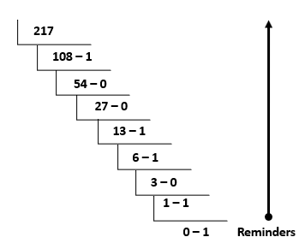
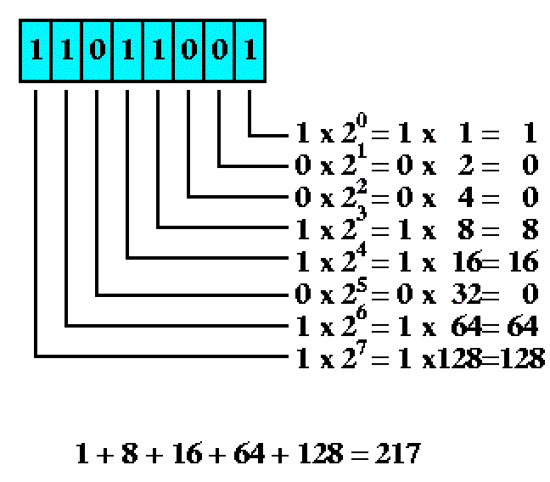
Number conversions for r = 2 for Integers
Decimal to Binary
Binary to Decimal
(217)₁₀= (11011001)₂
Notes:
Make an example to make it clear for any base
Representations from any two radix (base) can be said equivalent if their decimals are equal. Example: (0011)₈ and (1001)₂ both are 9 in decimal
Decimal to any base r conversion can be done by dividing that number and its all quotients by r and accumulating its reminders in reverse way. (until integer quotient = 0)
But if the decimal number have a decimal point, fraction part should be handled in different way (next slide).

Slide 21
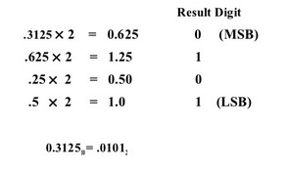
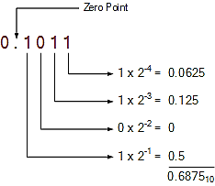
Number conversions for r=2 with Fractions
Decimal to Binary
Binary to Decimal
Radix point
Multiplication is used instead of division
Integers instead of reminders are considered
Notes:
For decimal to binary conversion, we have to account integer values carefully and accumulate them in sequential (in original order)
For binary to decimal conversion, we have to take the power as negative starting from -1.

Slide 22


Octal & Hexadecimal Numbers: Examples
Same procedure can be followed for fractions
Notes:
What is Complement?

Slide 23
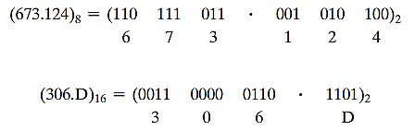
Octal & Hexadecimal Numbers: Examples…
Reverse way…

Slide 24
Complements of Numbers
Complements are used to simplify the subtraction operation
Concept: Make the subtrahend negative and add with minuend
Also used in different logical operation like negation
Two types of complements for any base r:
r’s complement or radix complement
(r-1)’s complement or diminished radix complement
Example: 2’s and 1’s complement in binary, 10’s and 9’s complement in decimal

Slide 25
Complement of a Number
Notes:
(r-1)’s complement can be achieved subtracting each digit from (r-1).
Example: in 10’s complement, (r-1)’s=9’s complement can be calculated as subtracting each decimal digit from 9.
Another way to work with fraction: perform the complement as if there were no radix point. After performing the calculation, place the radix point at the same relative position

Slide 26
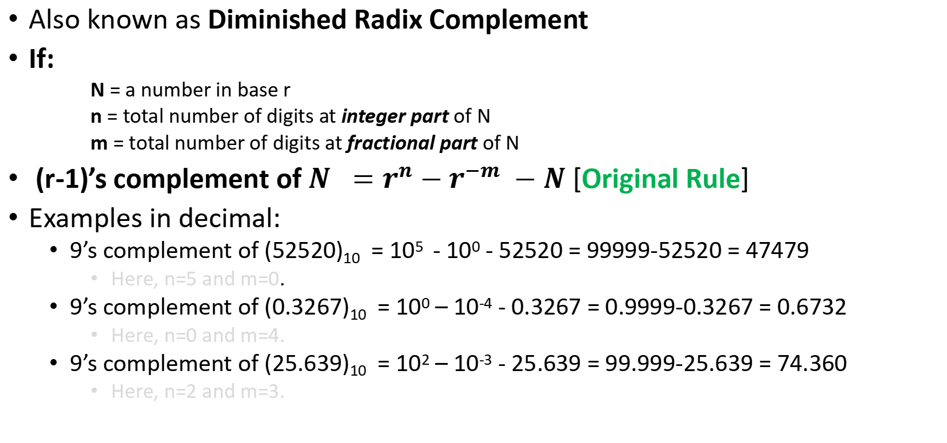
(r-1)’s Complement
Also known as Diminished Radix Complement
If:
N = a number in base r
n = total number of digits at integer part of N
m = total number of digits at fractional part of N
(r-1)’s complement of $N =r^{n}−r^{−m} −N$[Original Rule]
Examples in decimal:
9’s complement of (52520)₁₀ = 10⁵ - 10⁰ - 52520 = 99999-52520 = 47479
Here, n=5 and m=0.
9’s complement of (0.3267)₁₀ = 10⁰ – 10⁻⁴ - 0.3267 = 0.9999-0.3267 = 0.6732
Here, n=0 and m=4.
9’s complement of (25.639)₁₀ = 10² – 10⁻³ - 25.639 = 99.999-25.639 = 74.360
Here, n=2 and m=3.
Notes:
(r-1)’s complement can be achieved subtracting each digit from (r-1).
Example: in 10’s complement, (r-1)’s=9’s complement can be calculated as subtracting each decimal digit from 9.
Another way to work with fraction: perform the complement as if there were no radix point. After performing the calculation, place the radix point at the same relative position

Slide 27
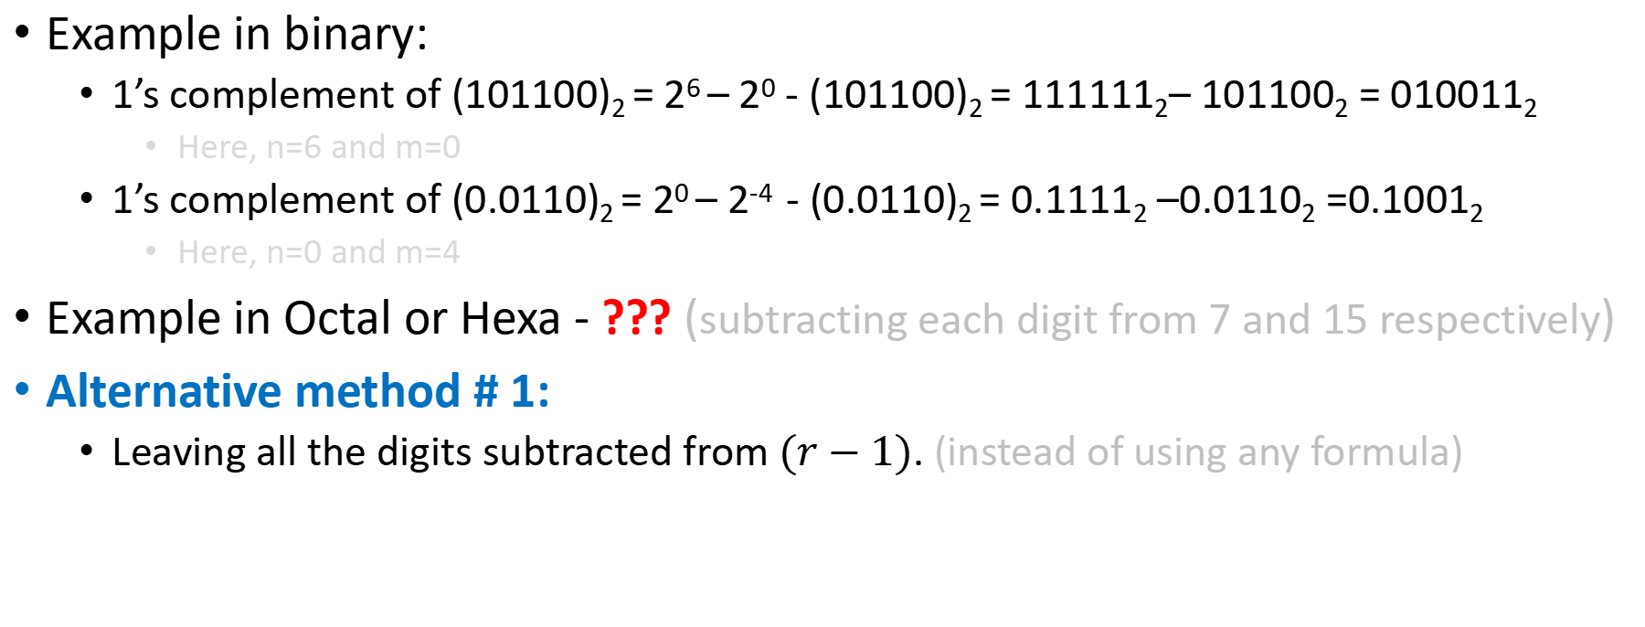
(r-1)’s Complement…
Example in binary:
1’s complement of (101100)₂ = 2⁶ – 2⁰ - (101100)₂ = 111111₂– 101100₂ = 010011₂
Here, n=6 and m=0
1’s complement of (0.0110)₂ = 2⁰ – 2⁻⁴ - (0.0110)₂ = 0.1111₂ –0.0110₂ =0.1001₂
Here, n=0 and m=4
Example in Octal or Hexa - ??? (subtracting each digit from 7 and 15 respectively)
Alternative method # 1:
Leaving all the digits subtracted from $(r−1)$. (instead of using any formula)
Notes:
Example: in 2’s complement, (r-1)’s=1’s complement can be calculated as subtracting each binary digit from 1. $i. e.$flipping each bit ($1→0$ or$0→1$)

Slide 28
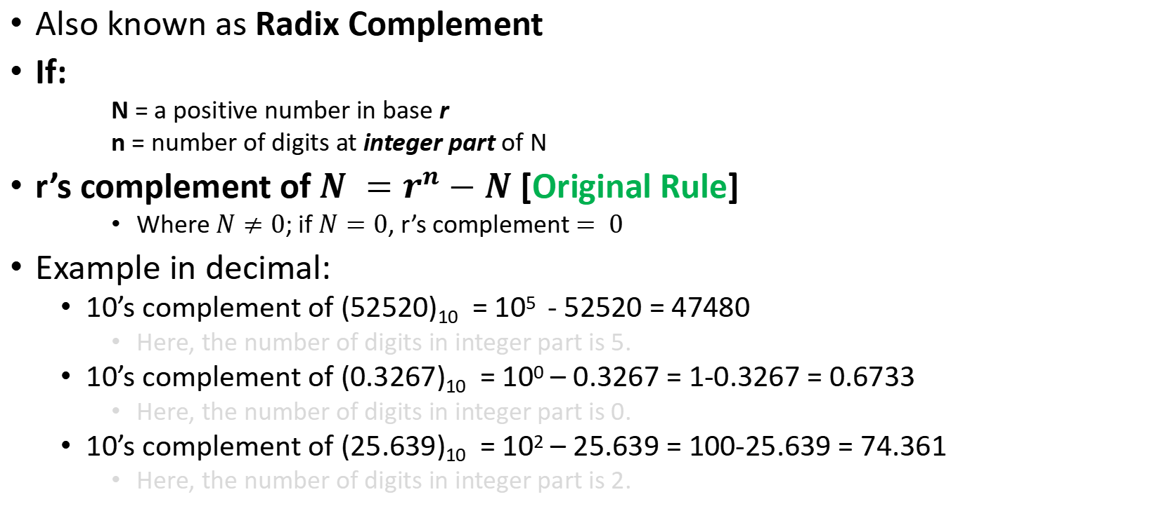
r’s Complement
Also known as Radix Complement
If:
N = a positive number in base r
n = number of digits at integer part of N
r’s complement of $N =r^{n}−N$[Original Rule]
Where $N≠0$; if $N=0$, r’s complement $= 0$
Example in decimal:
10’s complement of (52520)₁₀ = 10⁵ - 52520 = 47480
Here, the number of digits in integer part is 5.
10’s complement of (0.3267)₁₀ = 10⁰ – 0.3267 = 1-0.3267 = 0.6733
Here, the number of digits in integer part is 0.
10’s complement of (25.639)₁₀ = 10² – 25.639 = 100-25.639 = 74.361
Here, the number of digits in integer part is 2.
Notes:
Another way to work with fraction: perform the complement as if there were no radix point. After performing the calculation, place the radix point at the same relative position

Slide 29
r’s Complement…
Example in binary:
2’s complement of (101100)₂ = 2⁶ - (101100)₂ = 1000000₂ – 101100₂ =010100₂
Here, the number of digits in integer part is 6
2’s complement of (0.0110)₂ = 2⁰ - (0.0110)₂ = 1₂ – 0.0110₂ =0.1010₂
Here, the number of digits in integer part is 0
Alternative method # 1
Leaving all least significant zeros unchanged, next first non-zero least significant digit will be subtracted from r and next all higher significant digits will be subtracted from (r-1).
Alternative method # 2
Addition of r^{-m} with the (r-1)’s complement
Notes:
Octal and Hexa will follow the same rule.

Slide 30

Complement of Complement
Complement of the complement restores the number to its original value.
Proof: r’s complement of N is $(rn − N)$ and complement of $rn –(rn– N) = N$
Expression: $(A’)’ = A$

Slide 31
Complement of A Fraction: Alternative
Radix point can be removed temporarily and perform the r’s or (r-1)’s complement in any convenient method
Radix point should be restored to the complemented number at the same relative position

Slide 32
Subtraction with r’s Complement
Subtraction method uses the borrow concept – earlier intuitive method.
Easiest way for human being but less efficient for digital system
A 1 is borrowed from higher significant minuend position if the minuend digit is smaller than the subtrahend digit
Subtraction using complement is more efficient for computer system
Subtraction of two positive numbers (M-N); both of them being base r, done as follows (informal):
Add the minuend M to the r’s complement of the subtrahend N
Inspect the result obtained in step 1 for an end carry:
If an end carry occurs, discard it
If an end carry doesn’t occur, take the r’s complement of the result obtained in step 1 and place a negative sign in front of it

Slide 33
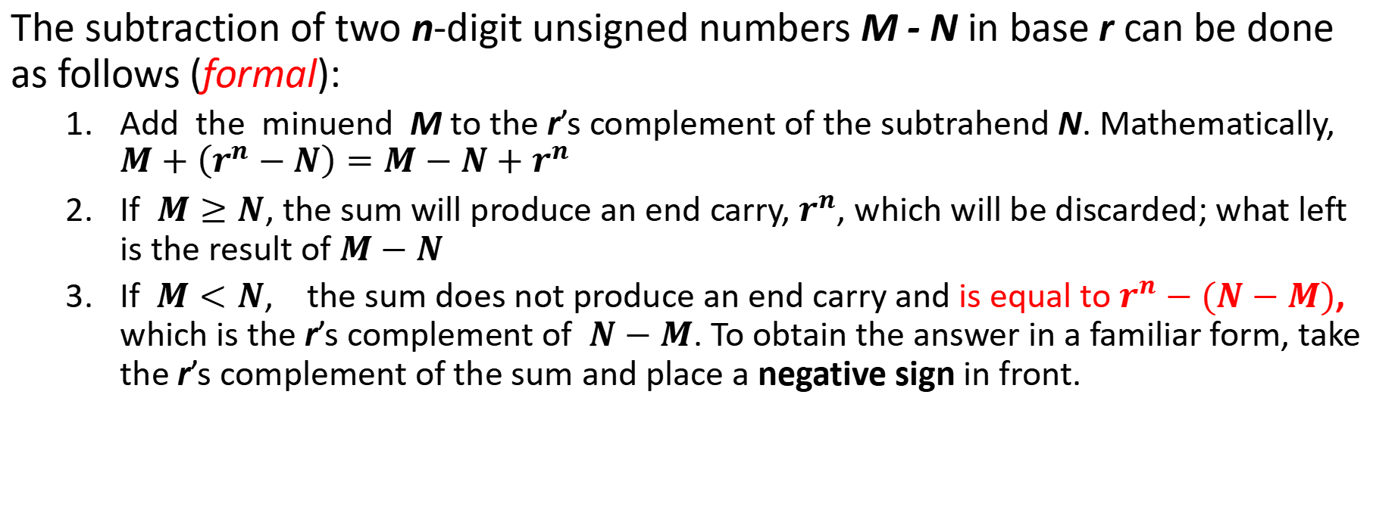
Subtraction with r’s Complement…
The subtraction of two n‐digit unsigned numbers M - N in base r can be done as follows (formal):
Add the minuend M to the r’s complement of the subtrahend N. Mathematically, $M+\left(r^{n}−N\right)=M−N+r^{n}$
If $M≥N$, the sum will produce an end carry, $r^{n}$, which will be discarded; what left is the result of $M−N$
If$M<N$, the sum does not produce an end carry and is equal to $r^{n}−(N−M)$, which is the r’s complement of $N−M$. To obtain the answer in a familiar form, take the r’s complement of the sum and place a negative sign in front.

Slide 34
Subtraction with r’s Complement…
Example:
M=72532₁₀ and N=03250₁₀ (Answer: 69282₁₀)
M=3250₁₀ and N=72532₁₀ (Answer: -69282₁₀)
M=1010100₂ and N=1000100₂ (Answer: 0010000₂)
M=1000100₂ and N=1010100₂ (Answer: -10000₂)
Proof: Homework

Slide 35
Subtraction with (r-1)’s Complement…
Similar with subtraction with r’s complement except for one variation called “end around carry”
Subtraction of two positive numbers (M-N) both of base r done as follows:
Add the minuend M to the (r-1)’s complement of the subtrahend N
Inspect the result obtained in step 1 for an end carry:
If an end carry occurs, add 1 to the least significant digit (end around carry)
If an end carry doesn’t occur, take the (r-1)’s complement of the result obtained in step 1 and place a negative sign in front
Notes:
In point 2.2, we no need to add to extra 1 with the result as like 2.1. Because the result is already is diminished by 1.

Slide 36
Subtraction with (r-1)’s Complement…
Example:
M=72532₁₀ and N=03250₁₀ (Answer: 69282₁₀)
M=3250₁₀ and N=72532₁₀ (Answer: -69282₁₀)
M=1010100₂ and N=1000100₂ (Answer: 0010000₂)
M=1000100₂ and N=1010100₂ (Answer: -10000₂)
Proof: Homework

Slide 37
Comparison between 1’s and 2’s Complements
Both have the advantages and disadvantages
Implementation:
1’s complement:
Easier to implement (changing of 0s and 1s)
2’s complement:
Implemented in any of the following two easier ways:
Adding 1 at the least significant digit of the 1’s complement
Leaving all ending 0s in the least significant positions and the first 1. Then changing all the 0s and 1s

Slide 38
Comparison between 1’s and 2’s Complements
Subtraction:
1’s complement:
Requires two arithmetic addition operations when an end around carry occurs
2’s complement:
Only one arithmetic addition operation is required
Another disadvantage of 1’s complement:
Two arithmetic zero: one with all 0s (positive zero) and another with all ones (negative zero)
Example: 1100-1100=0 (calculate using 1’s and 2’s complement)

Slide 39
Comparison between 1’s and 2’s Complements
Usage:
1’s complement used in logical inversion (unary operation)
Seldom used in arithmetic operation because of its some difficulties
2’s complement is only used in conjunction with arithmetic operation (specially in subtraction).
Note: So, when only word “complement” is occurred, it will refer to 1’s complement

Slide 40
Overflow during Addition
Important during operation with signed binary numbers
Problem: the magnitude exceeds limit which can’t be represented with the allotted number of bits.
Approach:
If 2 Two's Complement numbers are added, and they both have the same sign (both positive or both negative), then overflow occurs if and only if the result has the opposite sign.
Overflow occurs if:
(+A) + (+B) = −C
(−A) + (−B) = +C
(−7) 1001
+ (−6) 1010
------------
(−13) 1 0011 = 3
= Overflow; as the result is positive. aa(where the largest −ve number is −8)

Slide 41
Overflow : Summary
For signed integers:
Carry of the MSB bit is ignored, and overflow occurs if the addition operation adds two operands of the same sign, and results in a result of the opposite sign.
For unsigned integers:
Overflow occurs when carry occurs at MSB position.
Underflow:
If it is impossible to store a small number (floating number/ fractional number) with precision
If it produces a smaller number than the least possible value, it will exceed the designated space.
Ultimately, we treat underflow as an overflow in a sense.

Slide 42
Signed Binary Number
In decimal number system and ordinary arithmetic, it is easier to represent a positive and a negative number
A negative number is indicated by a minus sign and a positive number is indicated by a plus sign
Because of hardware limitation, it is customary to use MSB as sign bit
Signed-magnitude system
The convention is to make sign bit 0 for positive and sign bit 1 for negative number
Point to be noted: Both signed and unsigned binary numbers consist of 0s and 1s. User himself has to determine if the number is signed or unsigned
Example: (11001)₂ can be equivalent of 25 or -9 as per consideration.

Slide 43
Signed Binary Number…
Alternatively for arithmetic operations, signed-complement system is more convenient to represent a negative number in binary system
In this system, a negative number is indicated by its complement (either r’s or (r-1)’s complement)
Usually, a positive number starts with 0, whereas a complement starts with 1 (negative)
Between 1’s and 2’s complement, 2’s complement is more preferable
Practically, for any negative number in 1’s or 2’s complement, MSB should be 1.
Example:
A number +9 represented in 1 byte storage as 00001001
But negative number -9 can be represented as:
Signed-magnitude representation = 10001001
Signed-1’s-complement representation = 11110110
Signed-2’s-complement representation = 11110111
Note: In all cases in negative numbers, we get 1 in MSB position

Slide 44
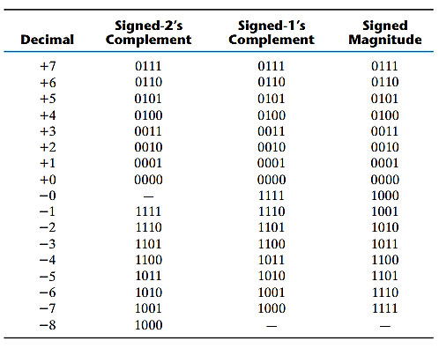
Signed Binary Number: Comparison Table
Notes:
All the three representations are identical for positive numbers
But signed 1’s complement and signed magnitude representation have two zeros (positive and negative), whereas signed 2’s complement has single zero (positive)
Signed-magnitude is awkward for computer arithmetic, because here it has to handle sign and magnitude part separately
-8 (1000) is negative in 4-bit number to make other addition operations consistent (2-8)

Slide 45
Arithmetic Addition
If we perform addition following the rules of ordinary arithmetic, we have to consider the sign and the magnitude separately
To calculate the final sign of the result we have to compare those magnitudes
Same rules will be applied in binary if signed-magnitude system is followed
Example: addition of +25 and -37
In contrast, if signed-complement system is followed, there is no such difficulties to compare the magnitudes or handle the signs separately
Rather simple addition is applied here
Concept: In this type of addition, negative value must be represented in 2’s complement form and carry out of the sign bit position (MSB) is discarded
Advantage: If the result is negative, the result obtained is automatically in 2’s complement form
You might perform the 2’s complement of the result again and put a minus sign in front of it.

Slide 46
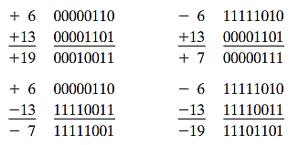
Arithmetic Addition: Example
Note: Overflow problem should be maintained as the storage in computer system is limited
Notes:
This overflow problem is occurred if we deal with the numbers having n bits but result it produced is (n+1) bits. Then this extra single bit can not be adjusted with the given capacity causing an error.
But this problem can’t be happened with pen and paper as we don’t face any kind of shortage of width of paper here.

Slide 47

Arithmetic Subtraction
Subtraction in signed-2’s-complement format:
Concept: Take the 2’s complement of the subtrahend (including sign bit) and add it to the minuend (including sign bit)
A carry out of the MSB position is discarded
In signed-2’s-complement, all subtraction operations are changed to addition operations as follows:
Notes:
Both signed and unsigned numbers will follow the same rule to perform addition and subtraction.
So common hardware circuit is enough to handle them both. So, the programmer/user should be careful about the representation of the number whether they are signed or unsigned.

Slide 48
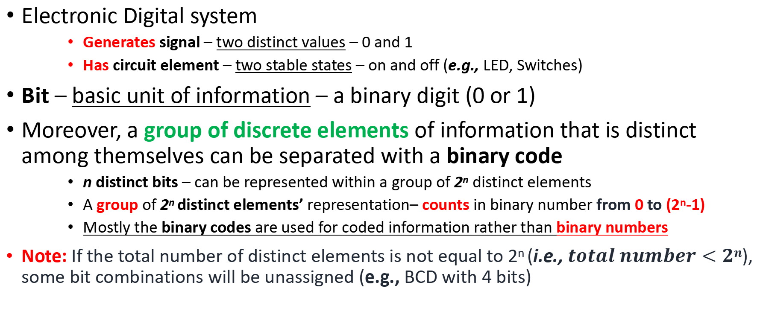
Binary Code
Electronic Digital system
Generates signal – two distinct values – 0 and 1
Has circuit element – two stable states – on and off (e.g., LED, Switches)
Bit – basic unit of information – a binary digit (0 or 1)
Moreover, a group of discrete elements of information that is distinct among themselves can be separated with a binary code
n distinct bits – can be represented within a group of 2^{n} distinct elements
A group of 2^{n} distinct elements’ representation– counts in binary number from 0 to (2^{n}-1)
Mostly the binary codes are used for coded information rather than binary numbers
Note: If the total number of distinct elements is not equal to 2^{n} (i.e., $total number<2n$), some bit combinations will be unassigned (e.g., BCD with 4 bits)
Notes:
There are minimum number of bits for 2^{n} distinct elements = n. But there is no maximum range to represent them separately.

Slide 49
Decimal in Binary Code
As computer only accepts binary form, numbers are represented in binary (through conversion) or in decimal through binary code – used as:
Storage of information
Arithmetic operation as binary form
Binary codes for decimal digits require minimum 4 bits (Why?)
Binary Coded Decimal (BCD) – as binary equivalent
Weight – 8,4,2,1
BCDs are one kind of decimals in representation using binary codes rather than 0,1,…9
For a decimal number greater than 9, BCD representation needs more bits than its equivalent binary number
A decimal number with k decimal digits requires 4k bits in BCD
Notes:
We can also perform arithmetic operation directly on those BCDs.
Give some examples for better understanding

Slide 50
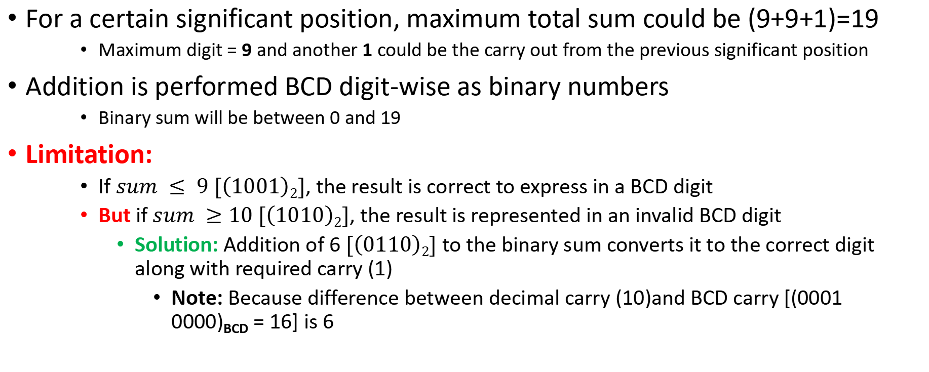
BCD Addition
For a certain significant position, maximum total sum could be (9+9+1)=19
Maximum digit = 9 and another 1 could be the carry out from the previous significant position
Addition is performed BCD digit-wise as binary numbers
Binary sum will be between 0 and 19
Limitation:
If $sum ≤ 9 [\left(1001\right)2]$, the result is correct to express in a BCD digit
But if $sum ≥10 [\left(1010\right)2]$, the result is represented in an invalid BCD digit
Solution: Addition of 6 $[\left(0110\right)2]$ to the binary sum converts it to the correct digit along with required carry (1)
Note: Because difference between decimal carry (10)and BCD carry [(0001 0000)_{BCD} = 16] is 6

Slide 51
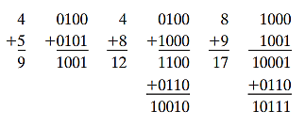
BCD Addition: Example # 1
Notes:
Give some examples for better understanding

Slide 52
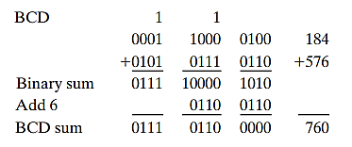
BCD Addition: Example # 2
Addition of two n-digit BCD numbers follows same procedure significant position wise:
Notes:
Give some examples for better understanding

Slide 53
BCD Arithmetic
Sign can be mentioned in BCD number using another 4-bits code
Signed-magnitude system
0000 for positive sign and 1001 for negative sign (***)
Also signed-complement system can also be used either in 9’s or in 10’s complement form
Signed-10’s complement is preferable
Each BCD digit will be 9’s complemented, and least significant BCD digit will be incremented by 1
Addition is done by summing all digit's position-wise and end carry will be discarded
Negative number should be converted to signed-10’s complement form
Like the arithmetic in signed-2’s complement system
Notes:
9’s complement = subtracting each decimal digit from 9. Give some examples
Many computer have their own special hardware circuit to perform the calculation directly with decimals in BCD which work based on user’s specification instead of converting them in binary.

Slide 54
Decimal in Other Binary Codes
Other binary codes also requires 4 bits per decimal digit
But these 4 bits can be combined in different ways into 10 distinct combinations
Other 6 out of 16 combinations have no meaning and should be avoided
Other binary codes as follows:
2421 – weighting factors 2,4,2,1
84-2-1 – weighting factors 8,4,-2,-1
Has both positive and negative weight
5043210 (Bi-quinary) – weighting factors 5,0,4,3,2,1,0
Each code has two 1s
Excess-3 – unweighted code
Obtained from the corresponding BCD+3
Notes:
Weighted code – each bit position is assigned a weighting factor in such a way that each digit can be calculated by adding the weight for those positions where there is a 1
Sometimes a digit can be coded into two different possible ways. Example: 4 in 2421 can be represented as 0100 and 1010. Both of them are correct, it should be chosen in a way so that self complement is achieved.
Options i, ii, and iv is used to get the 9’s complement directly changing 0s to 1s and vice versa
Option iii is used basically for error detection

Slide 55
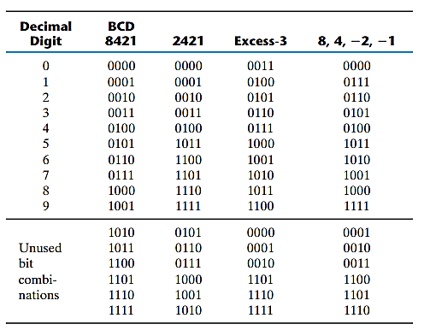
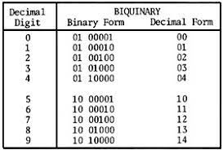
Decimal in Binary Code

Slide 56
Decimal in Binary Code: All at a Glance
BCD – most natural – equivalent to binary number
Excess 3, 84-2-1 and 2421
Self complementary
9’s complement can be obtained by flipping 1s and 0s (complementing each bit)
BCD is not self complementary
Excess-3 is an unweighted code used in older computer system for complementing
Example: 395 (001111111011)₂₄₂₁ and its 9’s complement 604 (110000000100)₂₄₂₁
Bi-quinary coded decimal
Error detection property – must have two 1s and five 0s for each digit

Slide 57
The Reflected Code or Gray Code
To convert continuous (analog) data to discrete one, sometimes reflected code is more beneficial over binary code
Primary benefit is that a number in the reflected code changes by only one bit as it proceeds from one number to the next.
Example: In natural binary number, state 3 (011) and state 4 (100) are in sequence but all three bits are different whereas reflected code for 3 (010) and 4 (110) overcome this problem
Reflected code is basically used where generating binary numbers by the hardware in normal sequence which may produce ambiguity during transition from one state to the next

Slide 58
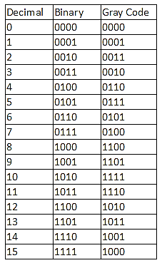
The Reflected Code: Comparison

Slide 59
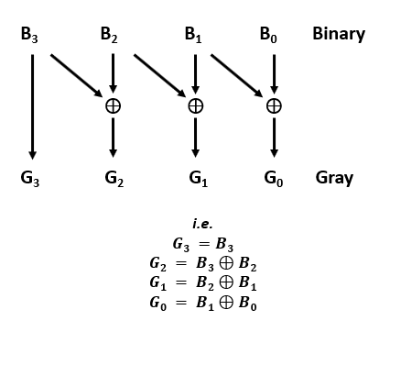
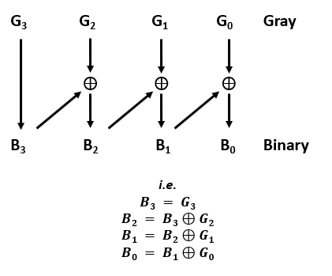
The Reflected Code: Approach
Notes:
MSB = 3
LSB = 0

Slide 60
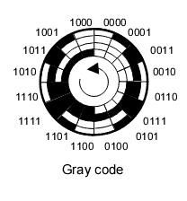
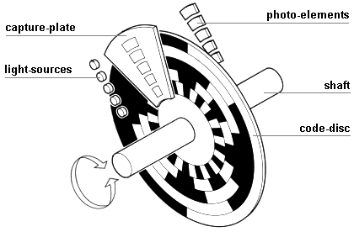
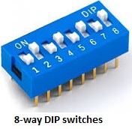
The Reflected Code: Real Life Examples
Example 1: To define a particular position/state through closing or opening switches, some ambiguous intermediate states may be generated.
Changing from state 3 (011) to state 4 (100), if any switch takes longer time to reflect its own state, it may cause an ambiguity
Example 2: Representation of analog magnitudes by a continuous change in angular position of a shaft
The circular shaft is partitioned into segments and each segment is designed in such a way that only one sensor will be able to sense a change using Gray code sequence

Slide 61
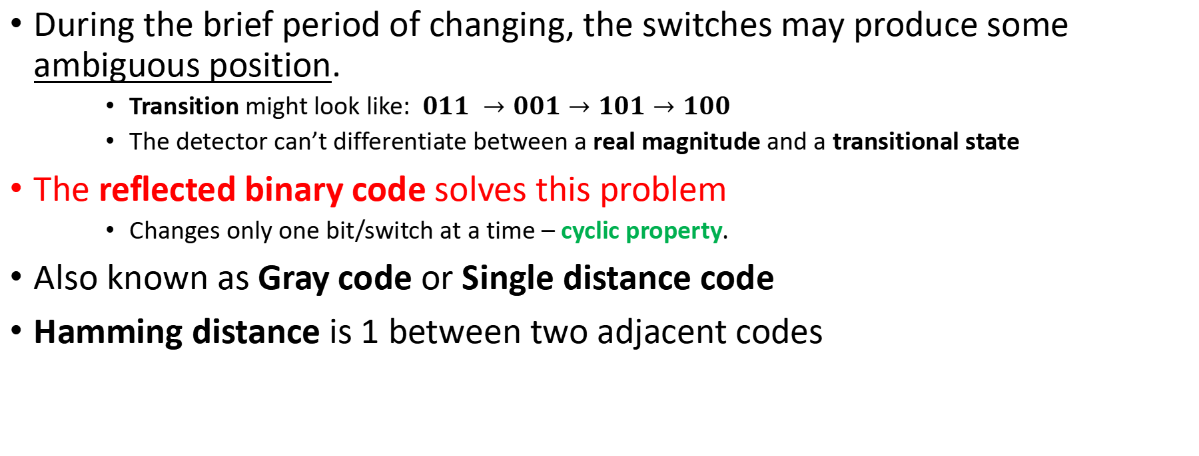
The Reflected Code: In Details
During the brief period of changing, the switches may produce some ambiguous position.
Transition might look like: $011 →001→101→100$
The detector can’t differentiate between a real magnitude and a transitional state
The reflected binary code solves this problem
Changes only one bit/switch at a time – cyclic property.
Also known as Gray code or Single distance code
Hamming distance is 1 between two adjacent codes

Slide 62
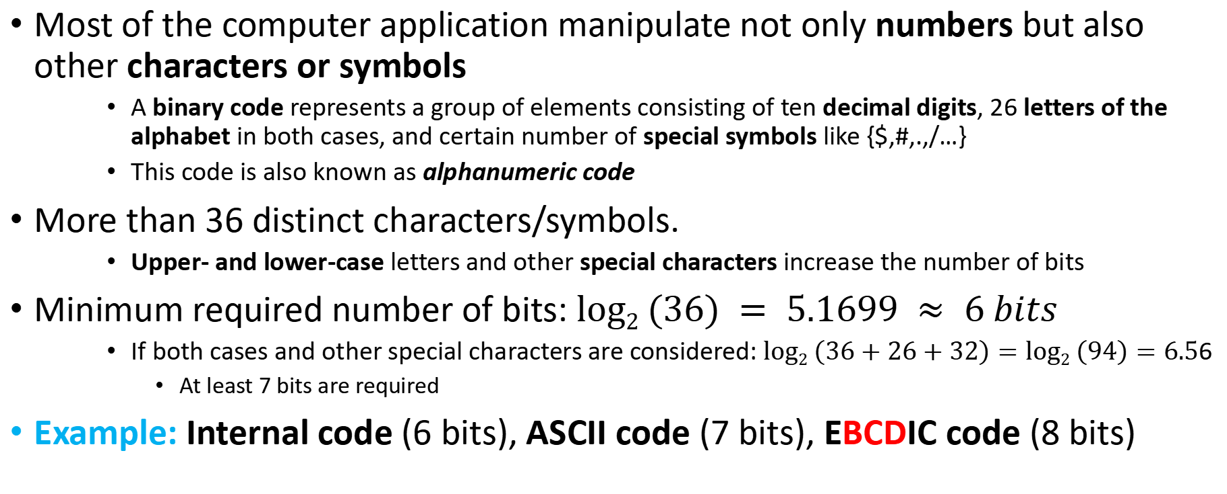
Alphanumeric Code
Most of the computer application manipulate not only numbers but also other characters or symbols
A binary code represents a group of elements consisting of ten decimal digits, 26 letters of the alphabet in both cases, and certain number of special symbols like {$,#,.,/…}
This code is also known as alphanumeric code
More than 36 distinct characters/symbols.
Upper- and lower-case letters and other special characters increase the number of bits
Minimum required number of bits: $log2 (36) = 5.1699 ≈ 6 bits$
If both cases and other special characters are considered: $log2 \left(36+26+32\right)=log2 \left(94\right)=6.5$6
At least 7 bits are required
Example: Internal code (6 bits), ASCII code (7 bits), EBCDIC code (8 bits)
Notes:
For EBCDIC and mostly ASCII codes are stored in one byte storage dedicating a single bit for error checking (e.g., parity bit)
“One byte per character” concept - Other Greek and Latin symbols also can be included here

Slide 63
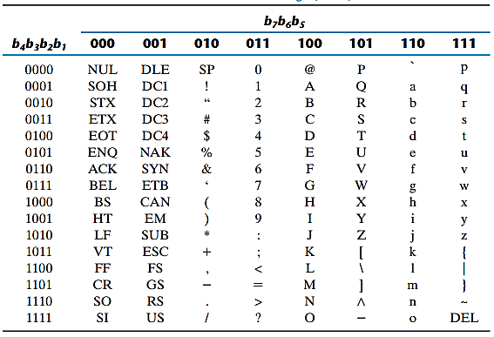
Alphanumeric Code: ASCII – Basic Characters
Notes:
ASCII: American Standard Code for Information Interchange

Slide 64
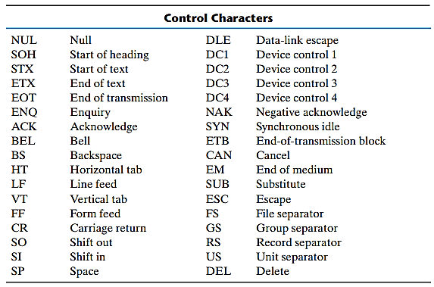
Alphanumeric Code: ASCII – Control Characters
Notes:
34 control characters are there to route data (data transmission) and arranging characters into a particular format.
Three types of control characters:
Format effectors – control the layout of printing – e.g. Backspace, horizontal tabulation, carriage return
Information separator – separate data into paragraphs or pages – e.g. record separator and file separator
Communication control – transmission of text in remote devices – e.g. STX (start of text) and ETX (end of text), ACK, NAK

Slide 65
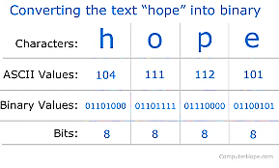
Alphanumeric Code: Example

Slide 66
Error Detection Code
Binary information is usually:
Transmitted through communication medium such as wires or radio waves
Processed in different electric circuitry
Problem: External Noise
During those above-mentioned operations, medium accidentally changes bit values from 0 to 1 or vice versa (alteration)
Solution: Error detection code
To detect error during operations
Detected error can’t be corrected but identified
Error Correction Code (?) - Alternative
Notes:
Error correction code (e.g., Hamming code) can also be used in modern technology to overcome this noise in the system

Slide 67
Error Detection Code: Types of Errors
Usual procedure is to observe the frequency of errors:
Randomly occurred error
Nothing to be done: Ignore
Retransmission of that message if an error is identified through NAK signal from receiver
Effect: Not that much effective error instead taking more time
Frequent occurred error
Severe problem - System must be checked for malfunction
Notes:
NAK control signal = Not Acknowledgement signal
ACK control signal = Acknowledgement signal

Slide 68
Error Detection Code: Approach
Parity bit – an extra bit included with the message to make the total number of 1s either odd or even
Handle of parity bit during information transfer –
Sending end (Transmitter)
Parity Generation – from the message, generate the parity bit, P
The message including its parity bit, P sent to the destination
Receiving End (Receiver)
Parity Check – all incoming bits are checked whether proper parity is maintained or not. If the checked parity does not correspond to the adopted one, error detected. Sends an NAK signal to the sender
If matched with adopted parity, discard the parity bit, P and sent to the original service. Sends ACK signal to the sender
Note: The parity method only detects the presence of odd number of errors. Even number of errors are undetectable. (Why?)
Notes:
NAK control signal = Not Acknowledgement signal
ACK control signal = Acknowledgement signal

Slide 69
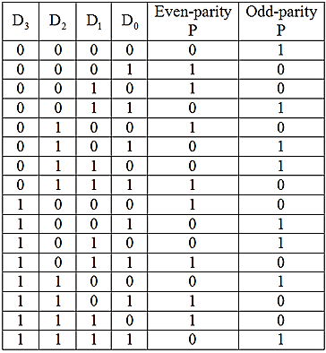
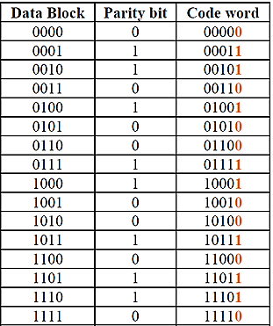
Error Detection Code: Example # 1
* Even parity is considered here

Slide 70

Error Detection Code: Example # 2
* Parity bit is included in MSB position

Slide 71
Binary Storage
Information in binary format stored in binary storage elements (binary cell) for individual bits as a physical existence
Binary Cell – having two stable states – store single bit of discrete information
Example: Binary cells as flip-flop, ferrite (magnetic) cores, punch card with holes
Excitation signal to set a state
1bit Cell
Sensing physical mode that differs between two states

Slide 72
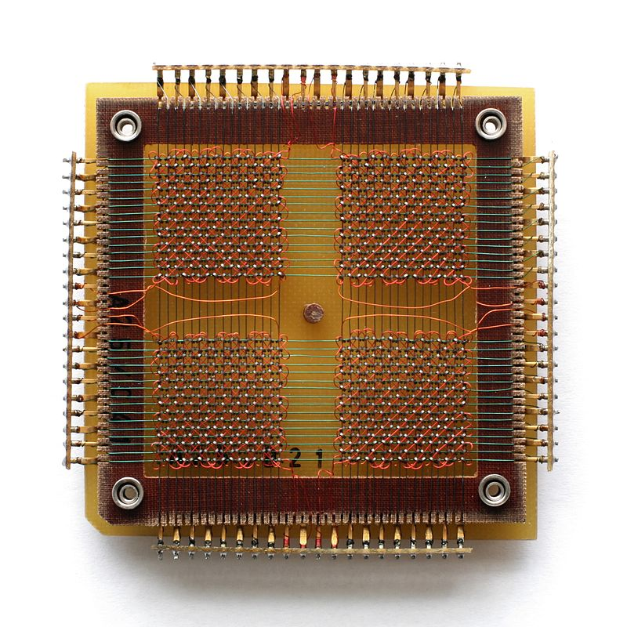
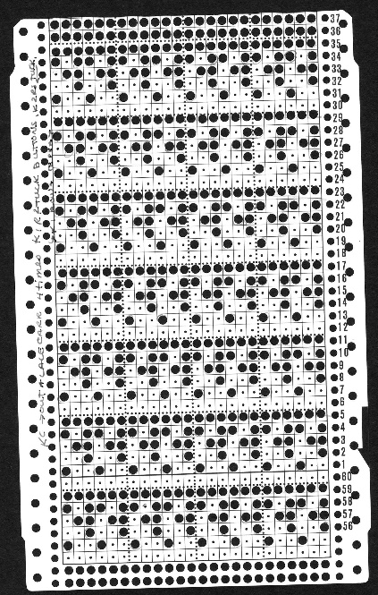
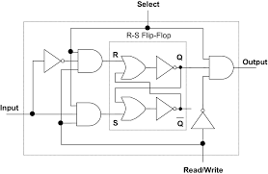
Binary Storage: Examples
Notes:
Flip-flop
Ferrite (magnetic) cores
Punch card with holes

Slide 73
Binary Storage: Memory Hierarchy
Register
Cache Memory
Main Memory (RAM, ROM)
Secondary Memory (SSD,HDD)
Notes:
Describe them based on storage size, speed, price, distance from processor, access for a processor

Slide 74
Registers
Register – a group of binary cells
n-cell register – store n bit discrete information of any combination of 0s and 1s
A “state” of a register – an n-tuple number (???) of 1s and 0s (i.e., in binary)
Each bit designating the state of one cell in the register
Content of a register – can be defined as a function of the interpretation of stored information in it.
Notes:
N-tuple - an ordered set with n elements.

Slide 75

Registers…
Example of 16 bits register:
A register with 16 cells can be one of the 2¹⁶ possible states
Same bit configuration may be interpreted differently for different types of information depending on the application
Types should be synched with the computer – e.g., string, integer, BCD, Excess-3 floating, image, audio, etc.
Notes:
N-tuple - an ordered set with n elements.

Slide 76
Register: Types
Registers in different components:
Processor Unit (ALU):
Store operands upon which operations are performed fetched from memory or I/O devices
Control Unit:
Keep track of various computer resources (i.e., supervision) as well as store control and status words for different components of computer
I/O devices:
Store information to be transferred to or from the I/O devices. Also known as “buffer”
To process binary information, a computer must have:
Storages which hold the data to be processed (Register)
Circuit elements which manipulate data (Logic circuit – ALU)

Slide 77
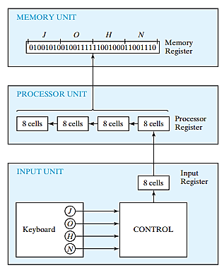
Transfer of Information among Registers
Register Level Operation
Notes:
From the keyboard 4 characters are fetched one by one, stored them in ALU (processing unit) and later store in main memory for further use – Programmed/Interrupt-driven I/O (not DMA)

Slide 78
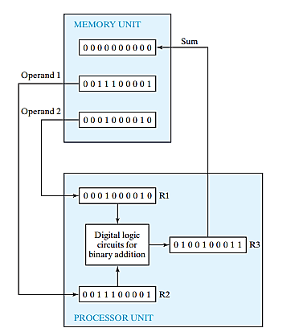
Example of Binary Information Processing
Register Level Operation
Notes:
To process binary data, a computer does need a storage device to hold binary data (register) and a circuit element to process that data (ALU)
Sometimes to store data for future, data could be store in memory (main memory, RAM)

Slide 79
Binary Logic
Binary logic consists of binary variables and a set of logical operations
Variables can be designated by letters from English alphabet
Deals with two discrete values (binary)
Values can be defined as either true or false, yes or no and so on
Important: Binary Logic and Binary Arithmetic are not same!
Binary Logic deals with only logic (1+1=1)
All variables represent any of the two discrete values
Binary Arithmetic deals with binary number (1+1=10)
All variables represent a binary number of one or more digits

Slide 80
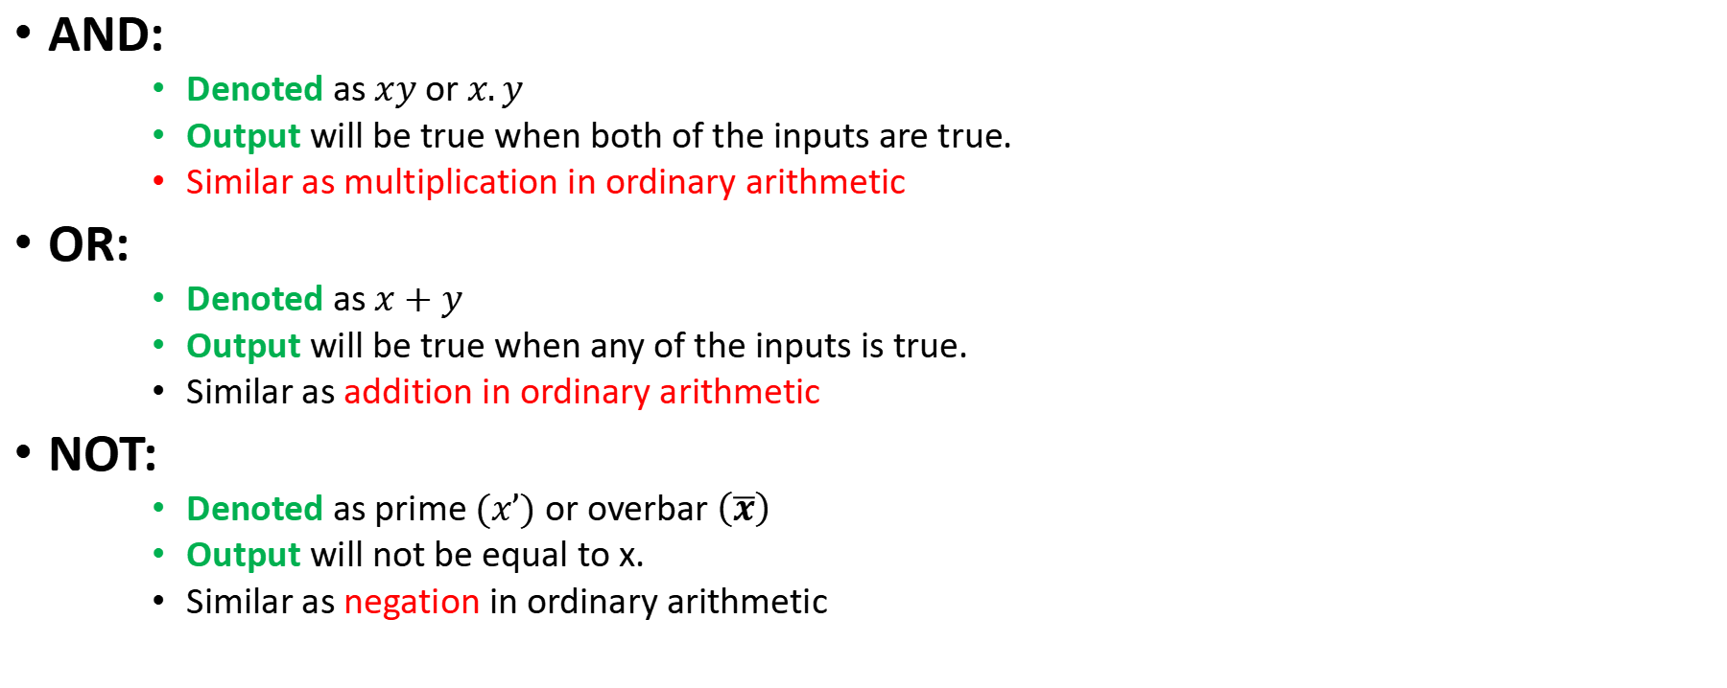
Binary Logic: Basic Logic Operations
AND:
Denoted as $xy$ or $x.y$
Output will be true when both of the inputs are true.
Similar as multiplication in ordinary arithmetic
OR:
Denoted as $x+y$
Output will be true when any of the inputs is true.
Similar as addition in ordinary arithmetic
NOT:
Denoted as prime $(x’)$ or overbar $\left(\overline{x}\right)$
Output will not be equal to x.
Similar as negation in ordinary arithmetic

Slide 81
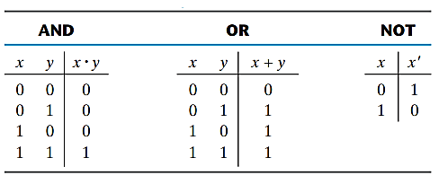
Binary Logic: Truth Table
Truth Table: A table consisting of all possible combinations of the input variables along with the corresponding output based on the definition of the logical operation.

Slide 82



Switching Circuits and Binary Signal
Application of Binary logic – simple switching circuits (made of switches)
Binary logic variable A can be represented as a switch A as following :
Electronic digital circuit uses transistor as switches – so named as switching circuit.
Conduct current – switch on
Not conducting current – switch off
Logic 1
Logic 0
Notes:
Switch: a switch is an electrical component that can disconnect (open) or connect (close) the conducting path in an electrical circuit and interrupt or divert it from one conductor to another.

Slide 83



Switching Circuits: Basic Logic Operations
L = A + B (OR)
L = A . B (AND)
Switch
A
bulb
L = A‘ (NOT)

Slide 84


Switching Circuits: Basic of Switch
Switches control electrical signal based on current or voltage
Voltage operated/controlled circuit – two separate voltage level
Output depends on input voltage
Example of Switch: FET (Field Effect Transistor)
Current operated/controlled circuit – (in transistors) cut off or saturation states
Output depends on input voltage
Example of Switch: BJT (Bipolar Junction Transistor)
Not gate
Notes:
Signal = 0 or 1

Slide 85
Logic Gates: Basic Idea
Logic gate: An electric circuit that operate on one or more input signals to generate an output signal based on specific requirement(s)
Establish a logical manipulation path producing one bit of information as output
Also named as digital circuit, logic circuit or switching circuit
Electrical signal (e.g., voltage and current) exists as analog signal which has continuous values over a range (e.g., 0v to 5v)
These analog data must be interpreted to either of two discrete values, 0 and 1
In ADC, input signal in the specified range is responded with binary signal in output terminal
Region between two allowed regions are crossed during the transition period

Slide 86

Logic Gates: Signal Levels

Slide 87


Logic Gates: Symbols
Notes:
Here A and B are input variables

Slide 88

Logic Gates: More than Two Inputs
Notes:
Here Gates with more than two inputs will follow the same definition specified earlier

Slide 89

Extra…
B₃ B₂ B₁ B₀ Binary
$⨁{ }⨁{ ⨁}$
G₃ G₂ G₁ G₀ Gray
i.e.
$$G3 =B3$$
$$G2 = B3⊕B2$$
$$G1 = B2⊕B1$$
$$G0 = B1⊕B0$$
Notes:
MSB = 3
LSB = 0

